Slide 1

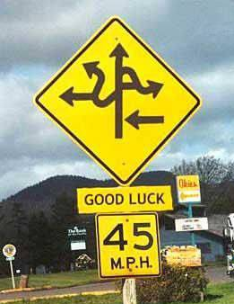
Introduction to Computer Science
Reichman University
Lecture 2-1
Conditional and Iterative Processing
Part I
Notes:
1

Slide 2
The big picture
any program you may want to write
objects
handling graphics, sound, and images
arrays
functions
conditionals and loops
math
text I/O
primitive data types
variables

Slide 3
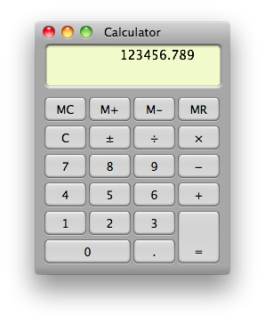
The big picture
any program you may want to write
objects
handling graphics, sound, and images
arrays
functions
conditionals and loops
this lecture
last week:
equivalent to a fancy calculator
math
text I/O
primitive data types
variables

Slide 4
Program flow
sequential flow:
conditional and iterative flow (example):
statement 1
condition
statement 2
true
false
statement 3
statements
condition
true
statements
etc.
false
statements
Program flow: Actual order of execution, during a program execution (runtime)
Conditionals and loops: Used to control the program flow.

Slide 5
Lecture plan
Conditional logic:
if
switch
Strings
Iterative logic:
while
for
do ... while

Slide 6
IF example
public static void main(String args[]) {
// computes and prints the absolute value of args[0]
int x = Integer.parseInt(args[0]);
if (x < 0) {
x = -x;
}
System.out.println("Absolute value: " + x);
}
% java AbsValue 5
Absolute value: 5
% java AbsValue -12
Absolute value: 12

Slide 7
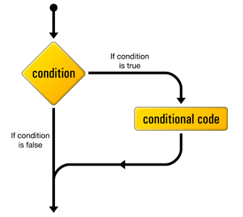

IF statement
Syntax:
Boolean expression;
if (condition) {
// we get here if condition is true
conditional code
}
// we get here always
code continues
One or more statements
(flow charts images are taken from http://articles.sitepoint.com/article/mysql-3-getting-started-php/3)

Slide 8
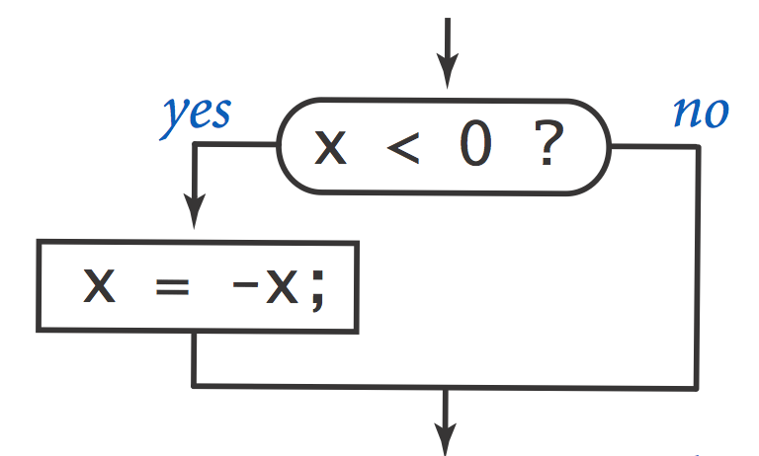
IF statement
// Sets x to abs(x)
if (x < 0) {
x = -x;
}
if (x < 0)
x = -x;
if (x < 0) x = -x;
Coding style:
Different styles, same semantics
Which style to use? The style that promotes safety and readability

Slide 9

IF statement
// Sets x to abs(x)
if (x < 0) {
x = -x;
}
if (x < 0)
x = -x;
if (x < 0) x = -x;
Coding style:
Different styles, same semantics
Which style to use? The style that promotes safety and readability
Convention: Use {blocked code} with braces, even when blocked code is only one statement
Read our Java Code Style Guidelines.

Slide 10
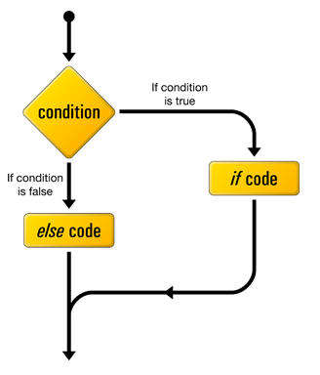
IF … ELSE statement
Boolean expression
Syntax:
if (condition)
if-code
else
else-code
One or more statements
One or more statements

Slide 11

IF … ELSE examples
public class Flip {
public static void main(String[] args) {
if (Math.random() < 0.5) {
System.out.println("Heads");
} else {
System.out.println("Tails");
}
}
}
% java Flip
Heads
% java Flip
Heads
% java Flip
Tails
% java Flip
Heads

Slide 12
IF … ELSE examples
// Computes max(x,y)
int max;
if (x > y) {
max = x;
} else {
max = y;
}
// Computes max(x,y)
int max = x;
if (y > max) {
max = y;
}
// Computes the roots of the quadratic equation x^2 + b*x + c = 0
double discriminant = b * b - 4.0 * c;
if (discriminant < 0.0) {
System.out.println("no real roots");
} else {
System.out.println("x1 = " + (-b + Math.sqrt(discriminant)) / 2.0);
System.out.println("x2 = " + (-b - Math.sqrt(discriminant)) / 2.0);
}

Slide 13
Nested code
// Compares variables a and b
if (a == b) {
System.out.println("a equals b");
} else {
if (a > b) {
System.out.println(a + " is greater");
} else {
System.out.println(b + " is greater");
}
}
nested if
if (a == b) { System.out.println("a equals b"); }
if (a > b) { System.out.println(a + " is greater"); }
if (a < b) { System.out.println(b + " is greater"); }
What’s the difference between the two code segments?

Slide 14
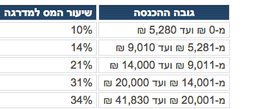
Example: tax calculation
Task: compute the applicable tax rate, according to income level.
if (income < 5280) {
rate = 0.10;
} else {
if (income < 9010) {
rate = 0.14;
} else {
if (income < 14000) {
rate = 0.21;
} else {
if (income < 20000) {
rate = 0.31;
} else {
rate = 0.34;
}
}
}
}
ואילך
Same results, different styles
if (income < 5280) rate = 0.10;
else if (income < 9010) rate = 0.14;
else if (income < 14000) rate = 0.21;
else if (income < 20000) rate = 0.31;
else rate = 0.34;
Notes:
nested conditionals: this is actually 4 different if-else statements, but no need for braces

Slide 15
The conditional operator: a shorthand if/else
Example
max = (a > b) ? a : b;

Slide 16
The conditional operator: a shorthand if/else
Example
Equivalent to:
max = (a > b) ? a : b;
if (a > b) max = a; else max = b;

Slide 17
The conditional operator: a shorthand if/else
Example
Equivalent to:
max = (a > b) ? a : b;
if (a > b) max = a; else max = b;
Syntax
If the condition is true,
the expression evaluates to expression1;
else,
the expression evaluates to expression2
condition ? expression1 : expression2 ;

Slide 18
The conditional operator: a shorthand if/else
Example
Equivalent to:
max = (a > b) ? a : b;
if (a > b) max = a; else max = b;
Syntax
If the condition is true,
the expression evaluates to expression1;
else,
the expression evaluates to expression2
condition ? expression1 : expression2 ;
Example
System.out.println("Thanks! you bought " + qty + ((qty > 1) ? "items" : "item"));
The conditional (also called ternary if) is similar to an if / else statement
But, the conditional is not a statement; it’s an expression that returns a value
In some cases, makes the code more readable; in other cases, more obscure
Use your judgement.

Slide 19
Lecture plan
Conditional logic:
if
Switch (will be covered in the recitation)
Strings
Iterative logic:
While
For
do ... while

Slide 20
Data types (revisited)
Primitive types
type | set of values | example values | typical operations
int | integer numbers | 17 -5034 | add, subtract, multiply, divide
double | floating point numbers | 3.1415 -171.19 | add, subtract, multiply, divide
boolean | truth values | true false | and, or, not
char | characters | 'c' 'K' '?' '5' '+' | compare
...
Represent “scalar” / single values
The Java language features eight primitive data types
Built-into the language
type | set of values | example values | typical operations
String | sequences of characters | "xckd” "hello world" | concatenate
Date | dates | 03/11/2018 | equals, greater than, less than
...
Object types
Represent “aggregates” of values
Java libraries feature many object types
More object types can be created as needed
Notes:
declaration: Java is strongly-typed, must specify type of each variable (avoid multiplying a string with a real number) Why?
variable: name to refer to data type value
assignment statement: changes the value of a variable

Slide 21
Strings
Java program
...
// Creates and initializes a variable of type String
String str = "Pine St. 7"; // Street address
...
0
1
2
3
4
5
6
7
8
9
str:
P
i
n
e
S
t
.
7
Memory
...
2017
80
'P'
2018
105
'i'
Abstraction
Implementation
2019
110
'n'
2020
101
'e'
2021
32
' '
2022
83
'S'
2023
116
't'
A String is an indexed sequence of characters (char values), each being a nonnegative integer in the range 0 to 65535.
2024
46
'.'
2025
32
' '
2026
55
'7'
...
(the addresses are an arbitrary example)

Slide 22
String operations
Examples
// Examples of string processing operations:
// (will be explained more fully later in the course)
String s = "Herzliya";
A sequence of 8 char values, indexed 0, 1, 2, ..., 7

Slide 23
String operations
Examples
// Examples of string processing operations:
// (will be explained more fully later in the course)
String s = "Herzliya";
System.out.println(s.charAt(0)); // 'H'
System.out.println(s.charAt(1)); // 'e'
System.out.println(s.charAt(7)); // 'a'
System.out.println(s.length()); // 8
System.out.println(s.charAt(s.length() - 1)); // 'a'
System.out.println(s.charAt(s.length())); // error
...
A sequence of 8 char values, indexed 0, 1, 2, ..., 7
s.length(): A function call, returns the length of s
s.charAt(i): A function call, returns the character at index i in s
(We’ll have more to say about the char and String types later in the course)

Slide 24
Lecture plan
Conditional logic:
if
switch
Strings (Intro, more later)
Iterative logic:
While
For
do ... while

Slide 25
WHILE loop
Example
// Prints 0 to N - 1
int count = 0;
while (count < N) {
System.out.println(count);
count = count + 1;
}
What will the program print when . . .
N = 3 ?
N = 1 ?
N = 0 ?
N = -3 ?
N = 1000 ?
Trace table:
An important debugging aide
Important:
Always think about, and test, “edge cases”

Slide 26
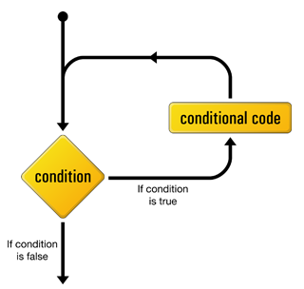
WHILE loop
Example
// Prints 0 to N - 1
int count = 0;
while (count < N) {
System.out.println(count);
count = count + 1;
}
Boolean expression
Syntax:
while (condition) {
conditional code
}
One or more statements
Note
A while loop executes zero or more times.

Slide 27
Example: String processing
// Deletes all the vowels (a, e, i, o, u) from a given string
public class DeleteVowels {
public static void main(String[] args) {
% java DeleteVowels router
rtr
% java DeleteVowels sync
sync
% java DeleteVowels example
xmpl
Algorithm
sIn = the input string
sOut = an empty, output string
vowels = "aeiou"
for each character in sIn:
if the character is not in vowels,
add it to sOut
s.length(): Returns the length of s
s.charAt(int): Returns the character at index int in s
s.indexOf(char): Returns the first index at which char appears in s, or -1 if not found

Slide 28
Example: String processing
// Deletes all the vowels (a, e, i, o, u) from a given string
public class DeleteVowels {
public static void main(String[] args) {
String s = args[0];
String sOut = "";
String vowels = "aeiou";
int i = 0;
while (i < s.length()) {
char c = s.charAt(i);
if (vowels.indexOf(c) == -1) {
sOut = sOut + c;
}
i++; // i = i + 1;
}
System.out.println(sOut);
}
}
% java DeleteVowels router
rtr
% java DeleteVowels sync
sync
% java DeleteVowels example
xmpl
Algorithm
sIn = the input string
sOut = an empty, output string
vowels = "aeiou"
for each character in sIn:
if the character is not in vowels,
add it to sOut
s.length(): Returns the length of s
s.charAt(int): Returns the character at index int in s
s.indexOf(char): Returns the first index at which char appears in s, or -1 if not found

Slide 29
Example: String processing
// Deletes all the vowels (a, e, i, o, u) from a given string
public class DeleteVowels {
public static void main(String[] args) {
String s = args[0];
String sOut = "";
String vowels = "aeiou";
int i = 0;
while (i < s.length()) {
char c = s.charAt(i);
if (vowels.indexOf(c) == -1) {
sOut = sOut + c;
}
i++; // i = i + 1;
}
System.out.println(sOut);
}
}
% java DeleteVowels router
rtr
% java DeleteVowels sync
sync
% java DeleteVowels example
xmpl
Algorithm
sIn = the input string
sOut = an empty, output string
vowels = "aeiou"
for each character in sIn:
if the character is not in vowels,
add it to sOut
Note
In this program we use the + operator (concatenation) to build the string incrementally;
There are more efficient ways to build strings incrementally (later).

Slide 30
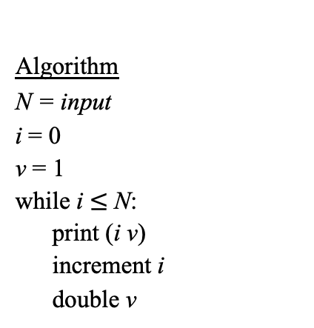
Example: Powers of 2
Task: Print powers of 2: 2⁰, 2¹, 2², 2³, … , 2^{N}
% java PowersOfTwo 3
0 1
1 2
2 4
3 8
% java PowersOfTwo 6
0 1
1 2
2 4
3 8
4 16
5 32
6 64
public class PowersOfTwo {
public static void main(String[] args) {
Algorithm
N = input
i = 0
v = 1
while i $≤$ N:
print (i v)
increment i
double v

Slide 31
Example: Powers of 2
Task: Print powers of 2: 2⁰, 2¹, 2², 2³, … , 2^{N}
% java PowersOfTwo 3
0 1
1 2
2 4
3 8
% java PowersOfTwo 6
0 1
1 2
2 4
3 8
4 16
5 32
6 64
public class PowersOfTwo {
public static void main(String[] args) {
int N = Integer.parseInt(args[0]);
int i = 0;
int v = 1;
while (i <= N) {
System.out.println(i + " " + v);
i++; // i = i + 1;
v *= 2; // v = v * 2;
}
}
}
Algorithm
N = input
i = 0
v = 1
while i $≤$ N:
print (i v)
increment i
double v

Slide 32
Example: Powers of 2 / buggy version
Task: Print powers of 2: 2⁰, 2¹, 2², 2³, … , 2^{N}
% java PowersOfTwo 6
0 1
0 1
0 1
0 1
0 1
0 1
0 1
0 1
0 1
0 1
0 1
...
public class PowersOfTwo {
public static void main(String[] args) {
int N = Integer.parseInt(args[0]);
int i = 0;
int v = 1;
while (i <= N)
System.out.println(i + " " + v);
i++; // i = i + 1;
v *= 2; // v = v * 2;
}
}
Bug: The curly braces around the body of the loop are missing.

Slide 33
Example: Palindromes
radar
kayak
racecar

Slide 34
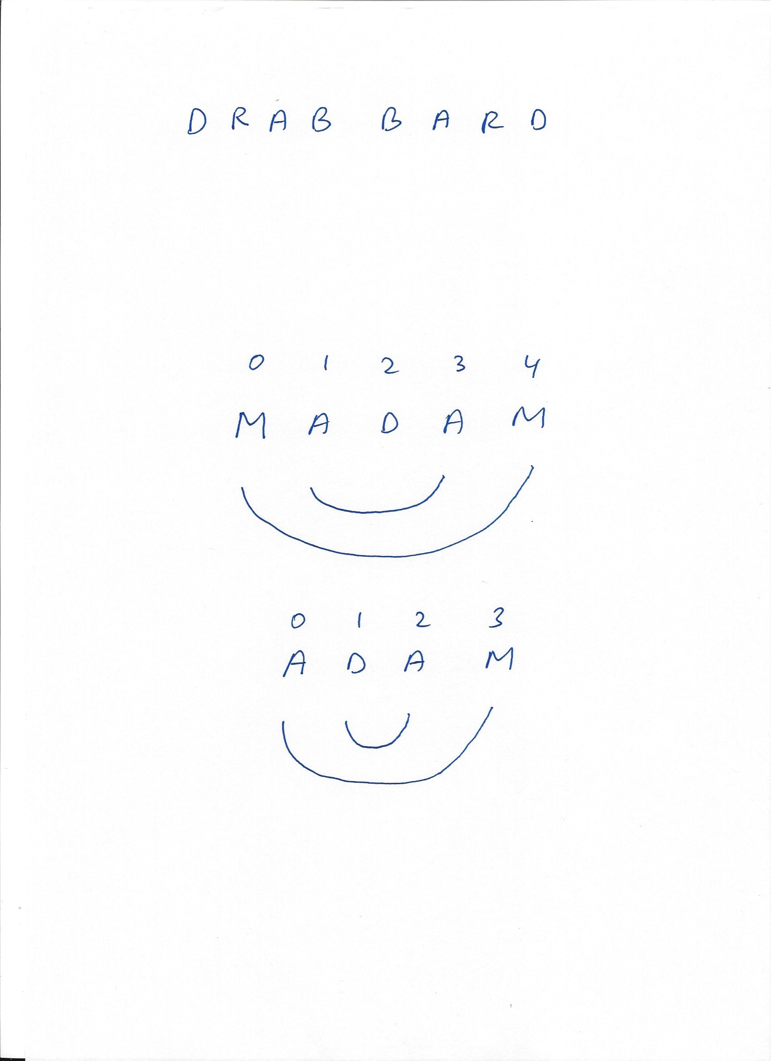


Example: Palindromes
radar
kayak
racecar
drab bard
Rise to vote, sir
Dennis and Edna sinned
Doom an evil deed, liven a mood
Go hang a salami; I’m a lasagna hog
A man, a plan, a canal, Panama
Rules of the game:
Ignore: white space, upper/lower case, punctuation characters
A single character string is a palindrome
An empty string is a palindrome.

Slide 35
Example: Palindromes
% java Palindrome adam
adam is not a palindrome
% java Palindrome madam
madam is a palindrome
public class Palindrome {
public static void main(String[] args) {
String s = args[0];
Relevant string processing functions
s.length(): Returns the length of s
s.charAt(int): Returns the character at index int in s
s.indexOf(char): Returns the first index at which char appears in s, or -1 if not found

Slide 36
Example: Palindromes
% java Palindrome adam
adam
0
3
public class Palindrome {
public static void main(String[] args) {
String s = args[0];
int left = 0;
int right = s.length() - 1;
// sanity check: Makes sure that we have a good start
System.out.println(s);
System.out.println(left);
System.out.println(right);
}
Relevant string processing functions
s.length(): Returns the length of s
s.charAt(int): Returns the character at index int in s
s.indexOf(char): Returns the first index at which char appears in s, or -1 if not found

Slide 37
Example: Palindromes
% java Palindrome adam
adam is not a palindrome
% java Palindrome madam
madam is a palindrome
public class Palindrome {
public static void main(String[] args) {
String s = args[0];
int left = 0;
int right = s.length() - 1;
while ((s.charAt(left) == s.charAt(right)) && (left < right)) {
left++;
right--;
}
if (left < right) {
System.out.println(s + " is not a palindrome");
} else {
System.out.println(s + " is a palindrome");
}
}
}
Relevant string processing functions
s.length(): Returns the length of s
s.charAt(int): Returns the character at index int in s
s.indexOf(char): Returns the first index at which char appears in s, or -1 if not found

Slide 38
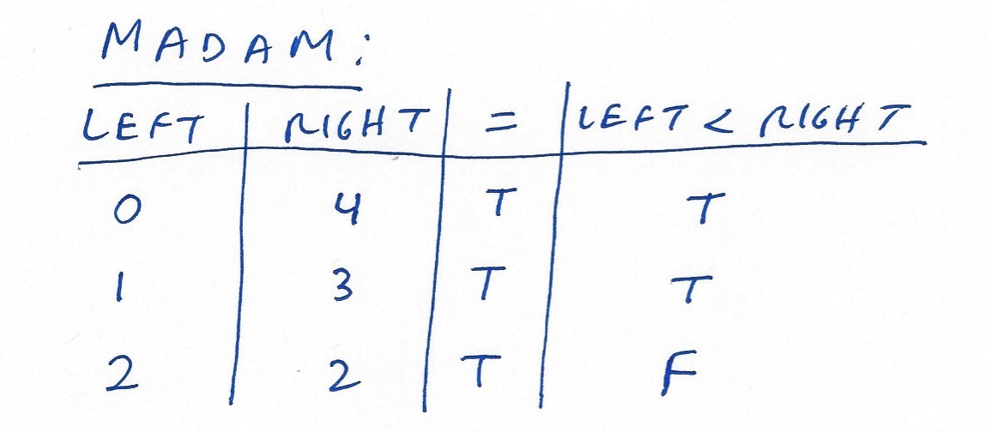
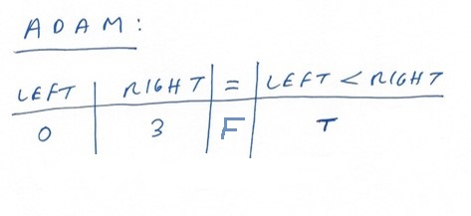
Example: Palindromes
% java Palindrome adam
adam is not a palindrome
% java Palindrome madam
madam is a palindrome
public class Palindrome {
public static void main(String[] args) {
String s = args[0];
int left = 0;
int right = s.length() - 1;
while ((s.charAt(left) == s.charAt(right)) && (left < right)) {
left++;
right--;
}
if (left < right) {
System.out.println(s + " is not a palindrome");
} else {
System.out.println(s + " is a palindrome");
}
}
}

Slide 39
Example: Print square
% java PrintSquare 3
***
***
***
public class PrintSquare {
public static void main(String[] args) {
int n = Integer.parseInt(args[0]);
Relevant printing functions
System.out.print(str): Prints the string str at the cursor position, and moves the cursor just after str
System.out.println(str): Prints str at the cursor position, and moves the cursor to the beginning on the next line
System.out.println(): Moves the cursor to the beginning on the next line

Slide 40
Example: Print square
% java PrintSquare 3
***
***
***
public class PrintSquare {
public static void main(String[] args) {
int n = Integer.parseInt(args[0]);
int i = 0;
// Iterates through square rows
while (i < n) {
// Iterates through square columns
int j = 0;
while (j < n) {
System.out.print("*");
j++;
}
System.out.println();
i++;
}
}
}
nested while
Relevant printing functions
System.out.print(str): Prints the string str at the cursor position, and moves the cursor just after str
System.out.println(str): Prints str at the cursor position, and moves the cursor to the beginning on the next line
System.out.println(): Moves the cursor to the beginning on the next line

Slide 41
Self practice
Write these programs:
% java PrintSquare 3
***
***
***
(done)
% java PrintLeft 3
*
**
***
% java PrintRight 3
*
**
***
Relevant printing functions
System.out.print(str): Prints the string str at the cursor position, and moves the cursor just after str
System.out.println(str): Prints str at the cursor position, and moves the cursor to the beginning on the next line
System.out.println(): Moves the cursor to the beginning on the next line
% java PrintCentered 3
*
***
*****

Slide 42
Lecture plan
Conditional logic:
if
Switch (will be covered in the recitation)
Strings (Intro, more later)
Iterative logic:
While
For
do ... while

Slide 43
Introduction to Computer Science
Reichman University
Lecture 2-1
Conditional and Iterative Processing
Part I
Notes:
43

